Slide 1

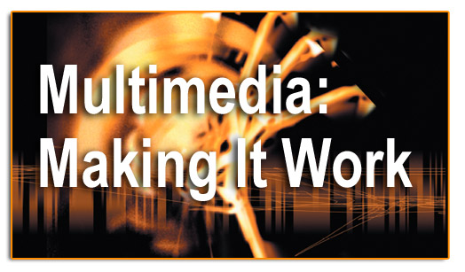
Chapter 6-Animation

Slide 2
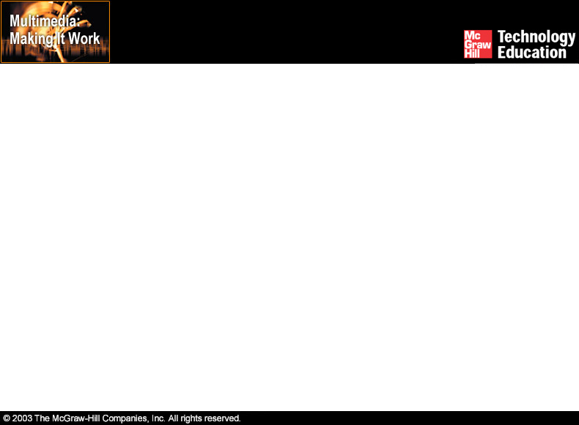
Objective
The students will be able to:
define animation and describe how it can be used in multimedia.
discuss the origins of cel animation and define the words that originate from this technique.
define the capabilities of computer animation and the mathematical techniques that differ from traditional cel animation.
discuss some of the general principles and factors that apply to the creation of computer animation for multimedia presentations.

Slide 3
Overview
Introduction to animation.
Computer-generated animation.
File formats used in animation.
Making successful animations.

Slide 4
Introduction to Animation
Animation is defined as the act of making something come alive.
It is concerned with the visual or aesthetic aspect of the project.
Animation is an object moving across or into or out of the screen.

Slide 5
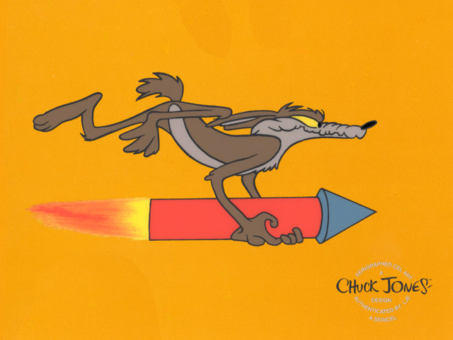
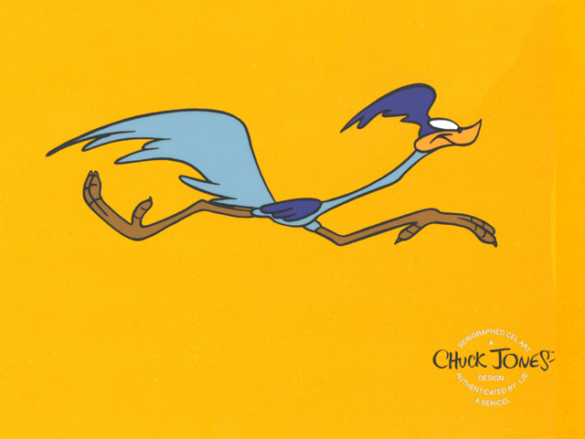
Introduction to Animation
Animation is possible because of a biological phenomenon known as persistence of vision and a psychological phenomenon called phi.
In animation, a series of images are rapidly changed to create an illusion of movement.

Slide 6

Usage of Animation
Artistic purposes
Storytelling
Displaying data (scientific visualization)
Instructional purposes

Slide 7
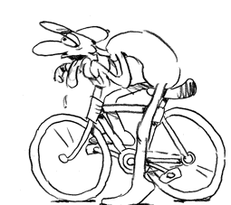
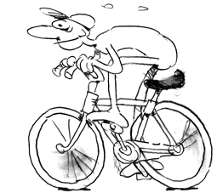
12 Basic Principles of Animation
Timing
  The basics are: more drawings between poses slow and smooth the action. Fewer drawings make the action faster and crisper. A variety of slow and fast timing within a scene adds texture and interest to the movement.

Slide 8
12 Basic Principles of Animation
Secondary Action
  This action adds to and enriches the main action and adds more dimension to the character animation, supplementing and/or re-enforcing the main action.

Slide 9
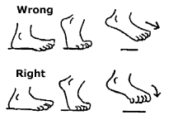

12 Basic Principles of Animation
Follow Through and Overlapping Action
  When the main body of the character stops, all other parts will continue to catch up to the main mass of the character, such as arms, long hair, clothing, coat tails or a dress, floppy ears or a long tail (these follow the path of action). Nothing stops all at once

Slide 10
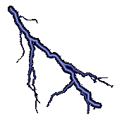

12 Basic Principles of Animation
Straight Ahead Action and Pose-To-Pose Action
  Straight ahead animation starts at the first drawing and works drawing to drawing to the end of a scene. You can lose size, volume, and proportions with this method, but it does have spontaneity and freshness. Fast, wild action scenes are done this way.

Slide 11
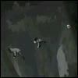

12 Basic Principles of Animation
  Pose-to-Pose action is more planned out and charted with key drawings done at intervals throughout the scene. Size, volumes, and proportions are controlled better this way, as is the action.

Slide 12



12 Basic Principles of Animation
Staging
  A pose or action should clearly communicate to the audience which the attitude, mood, reaction or idea of the character as it relates to the story and continuity of the story line. The effective use of long, medium, or close up shots, as well as camera angles also helps in telling the story.

Slide 13

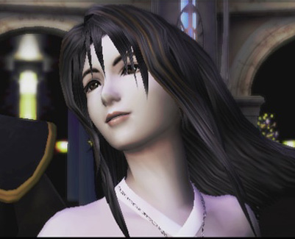
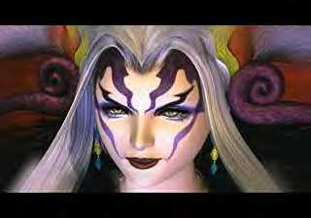
12 Basic Principles of Animation
Appeal
  A live performer has charisma. An animated character has appeal. Appealing animation does not mean just being cute and cuddly. All characters have to have appeal whether they are heroic, villainous, comic or cute.
  Appeal, as you will use it, includes an easy to read design, clear drawing, and personality development that will capture and involve the audience¹s interest.

Slide 14
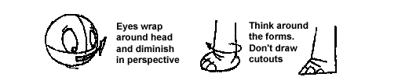
12 Basic Principles of Animation
Solid Drawing
  The basic principles of drawing form, weight, volume solidity and the illusion of three dimension apply to animation as it does to academic drawing.
  Transform these into color and movement giving the characters the illusion of three-and four-dimensional life. Three dimensional is movement in space.

Slide 15
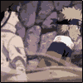

12 Basic Principles of Animation
Ease In and Out
  As action starts, we have more drawings near the starting pose, one or two in the middle, and more drawings near the next pose.
  Fewer drawings make the action faster and more drawings make the action slower. Slow-ins and slow-outs soften the action, making it more life-like

Slide 16
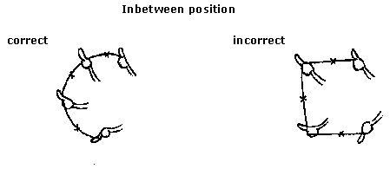
12 Basic Principles of Animation
Arcs
  All actions, with few exceptions (such as the animation of a mechanical device), follow an arc or slightly circular path.
  This is especially true of the human figure and the action of animals. Arcs give animation a more natural action and better flow.

Slide 17
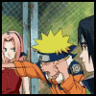
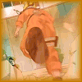


12 Basic Principles of Animation
Anticipation
  This movement prepares the audience for a major action the character is about to perform, such as, starting to run, jump or change expression.
  A dancer does not just leap off the floor. A backwards motion occurs before the forward action is executed. The backward motion is the anticipation.

Slide 18




12 Basic Principles of Animation
Squash and Stretch
  This action gives the illusion of weight and volume to a character as it moves. Also squash and stretch is useful in animating dialogue and doing facial expressions.

Slide 19

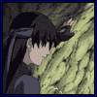
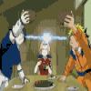
12 Basic Principles of Animation
Exaggeration
  Exaggeration is not extreme distortion of a drawing or extremely broad, violent action all the time. It’s like a caricature of facial features, expressions, poses, attitudes and actions.
  Exaggeration in a walk or an eye movement or even a head turn will give your animation more appeal.

Slide 20
Computer-Generated Animation
Animation space.
Animation techniques.

Slide 21
Animation Space
Animation can be rendered in:
  2-D space - 2-D animations are very simple and static.
  2-1/2D space - An illusion of depth is created through shadowing, highlighting, and forced perspective, though in reality the image rests in two dimensions.
  3-D space - Complicated and realistic animations are done in 3-D space.

Slide 22
Animation Techniques
Methods of creating animation (type of animation):
  Cel animation
  Path animation
Computer animation.
Animation process.

Slide 23
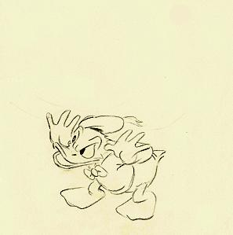
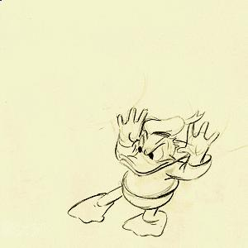
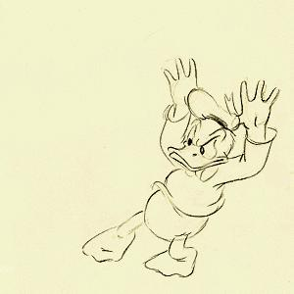
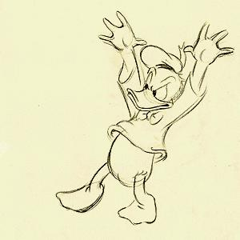
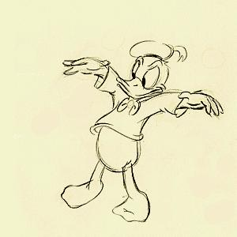
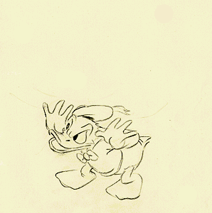
Type of Animation: Cel Animation
Cel animation is a technique in which a series of progressively different graphics are used on each frame of movie film.
The term "cel" is derived from the clear celluloid sheets that were used for drawing each frame.
Cel animation begins with keyframes.

Slide 24
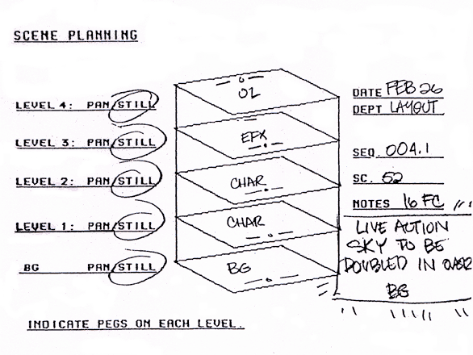
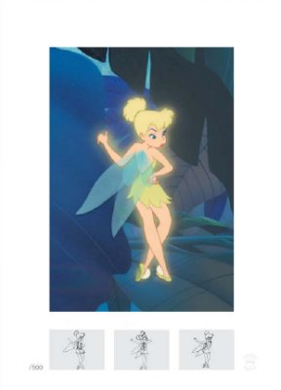
Type of Animation: Cel Animation
Keyframes refer to the first and the last frame of an action.
The frames in between the keyframes are drawn in the tweening process.
Tweening depicts the action that takes place between keyframes.
Tweening is followed by the pencil test.

Slide 25
Type of Animation: Path Animation
The movement of an object happened along a predetermined path on the screen.
The path could be a straight line or any number of curves.
The object does not change, although it might be resized or reshape.

Slide 26
Computer Animation
Electronically generated movement of anything on your computer screen.
Computer animation is very similar to cel animation.
The primary difference is in how much must be drawn by the animator and how much is automatically generated by the software.
Kinematics is the study of the movement and motion of structures that have joints.
Inverse kinematics is the process of linking objects, and defining their relationship and limits.

Slide 27
Computer Animation
Morphing is an effect in which a still or moving image is transformed into another.
Three different levels of computer animation:
  Basic
  Intermediate
  Advanced

Slide 28
Computer Animation
Basic
  At the most fundamental level, animation consists of simple transitions (wipes and dissolves between PowerPoint slides, for example) and path animations (moving text and logos).

Slide 29


Computer Animation
Intermediate
  The next level up is cell animation (the method used in cartoons) and special effects, which include all manner of distortions and color effects applied to a graphic, photo or movie.

Slide 30
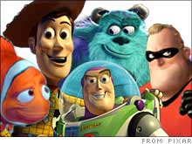
Computer Animation
Advanced
  The most sophisticated level of digital animation is 3D animation. Movies such as "Toy Story" and "A Bug's Life" are the most prominent examples of what can be achieved through the latest computer technology.
  Ambitious designers can take advantage of these same tools to manufacture some dazzling 3D creations of their own.

Slide 31
Animation Process
The steps to be followed in creating animation are:
  Organize the execution in a series of logical steps.
  Choose an animation tool best suited for the job.
  Build and tweak the sequences.
  Post-process the completed animation.

Slide 32
Creating Animation
2 step process for creating animations
  Step 1: Planning
  Step 2: Implementation
Step 1: Planning
  Decide on the problem to be solved
  Design a solution – storyboard
  Determine the characters and objects to appear on

Slide 33
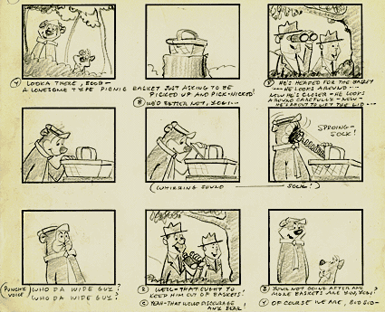
Creating Animation
Example of storyboard

Slide 34
Creating Animation
Step 2: Implementation
  Start production
  Post-production
  Test playback and review
  Amendments
  Delivery or packaging

Slide 35
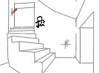
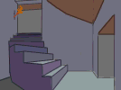
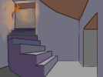
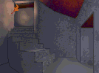
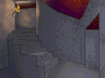
Creating Animation
Example of implementation

Slide 36
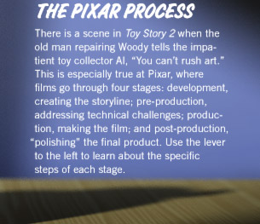
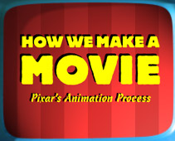
Example:
Pixar’s Animation Step for Monster’s Inc.

Slide 37
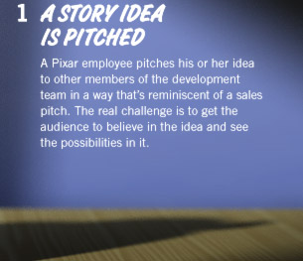
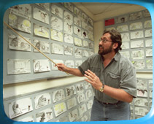
Example:
Pixar’s Animation Step for Monster’s Inc.
Step 1: Planning

Slide 38
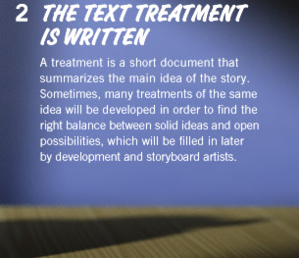
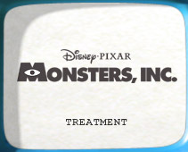
Example:
Pixar’s Animation Step for Monster’s Inc.

Slide 39
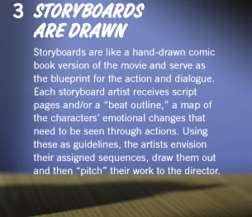
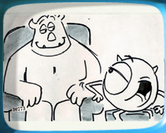
Example:
Pixar’s Animation Step for Monster’s Inc.

Slide 40
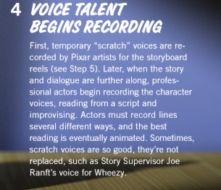
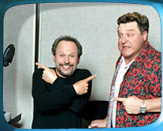
Example:
Pixar’s Animation Step for Monster’s Inc.

Slide 41
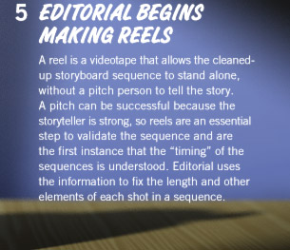
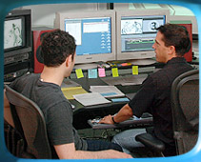
Example:
Pixar’s Animation Step for Monster’s Inc.

Slide 42
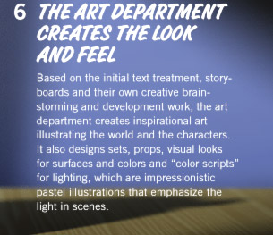
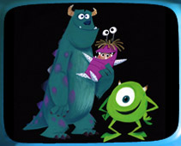
Example:
Pixar’s Animation Step for Monster’s Inc.

Slide 43
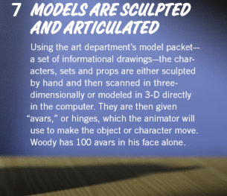
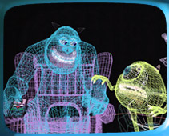
Example:
Pixar’s Animation Step for Monster’s Inc.
Step 2: Implementation

Slide 44
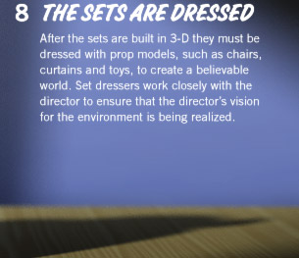

Example:
Pixar’s Animation Step for Monster’s Inc.

Slide 45


Example:
Pixar’s Animation Step for Monster’s Inc.

Slide 46


Example:
Pixar’s Animation Step for Monster’s Inc.

Slide 47


Example:
Pixar’s Animation Step for Monster’s Inc.

Slide 48


Example:
Pixar’s Animation Step for Monster’s Inc.

Slide 49


Example:
Pixar’s Animation Step for Monster’s Inc.

Slide 50


Example:
Pixar’s Animation Step for Monster’s Inc.

Slide 51
File Formats used in Animation
.dir and .dcr - Director files.
.fli and .flc - AnimatorPro files.
.max - 3D Studio Max files.
.pics - SuperCard and Director files.
.fla and .swf - Flash files.
GIF89a file format:
  It is a version of the GIF image format.
  GIF89a allows multiple images to be put into a single file and then be displayed as an animation in the Web browser.
  Applications like BoxTop Software's GIFmation or ULead's GIF Animator are needed to create GIF89a animation.

Slide 52
Making Successful Animations
Use animation carefully and sparingly.
High quality animations require superior display platforms and hardware, as well as raw computing horsepower.
File compression is very important when preparing animation files for the Web.

Slide 53
Making Successful Animations
Some animation tools are:
  Macromedia's Flash.
  Kai's Power Tools' Spheroid Designer.
  Alias|Wavefront's Maya.
  NewTek's Lightwave.

Slide 54
Summary
Animation is visual change over time and adds great power to multimedia.
Cell animation uses a series of progressively different graphics on each frame of movie film.
Computer animation has eased the process of creating animation.
Many file formats are designed specifically to contain animation.

